Slide 1
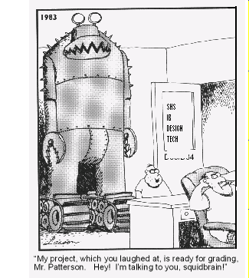
Conducting software project assessments
Kan, Ch 16
Steve Chenoweth, RHIT
Notes:
Cartoon from http://www.schenectady.k12.ny.us/users/pattersont/IBDT%20Website/DesignProject.html.

Slide 2
Tied to management decisions
Look at end-to-end processes used on a project.
May be at the end of an iteration or of a whole project.
At a point where perspective and reflection are likely to be in play.
Also done when a project is “in trouble.”
Consider how to improve overall development effectiveness and efficiency.
Or, cancel an in-process project.
An opportunity might be – “Do more quality assessments,” like described in Ch 15.

Slide 3
But there are variations!
All or part of some is in fact a “first person” assessment.
The company hires outsiders in a “second person” assessment.
Like an SEI “process assessment.”
Another party (like a supplier) supplies the reviewers in a “third person” assessment.
Like an SEI “capability assessment.”

Slide 4
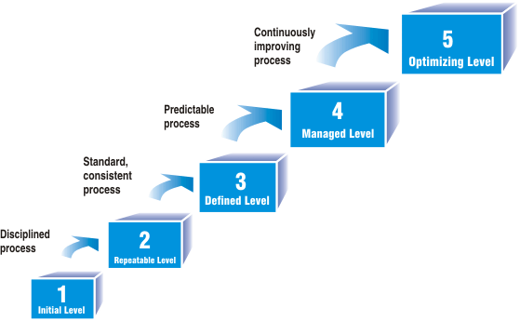
SEI maturity model assessments
These play a strong role in process improvement for some organizations:
Government work
Attracting similar “official” contract work
Like offshore contractors
Notes:
Image from http://www.estylesoft.com/?id=317&pid=1.

Slide 5
The CMM assessment cycle
Form a team.
Self-assessment by the organization being reviewed.
Analyze their questionnaire responses.
Conduct a site visit to understand their process.
Produce findings – strengths and weaknesses.
Prepare key process area (KPA) profile and present to appropriate audience.

Slide 6
Kan’s proposed software project assessment method
Notes:
P 421

Slide 7
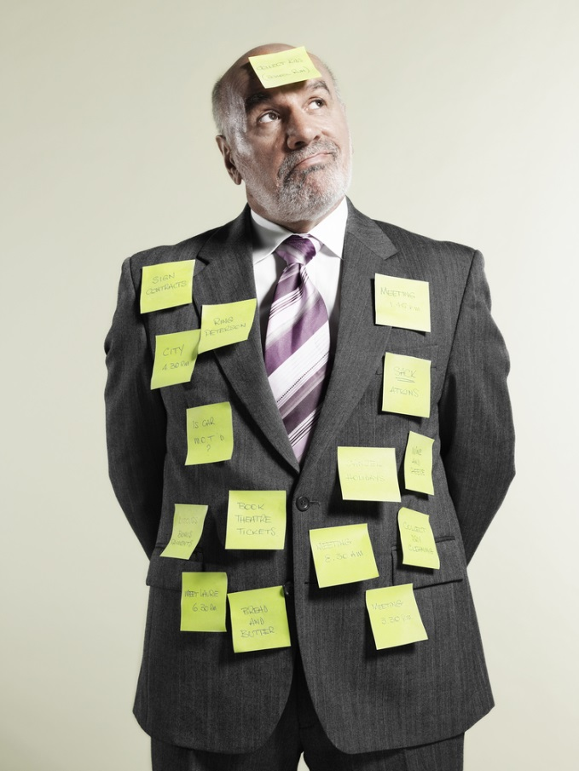
Kan’s list of failing project traits
Inadequate project planning
Inadequate cost estimating
Inadequate measurements
Inadequate milestone tracking
Inadequate quality control
Ineffective change control
Ineffective development process
Ineffective communications
Ineffective project managers
Inexperienced technical personnel
Generalists rather than specialists
Little or no reuse of technical material
Notes:
P 427
Image from http://www.todo2.co.uk/what-is-threads-collaboration-software/.

Slide 8
Or,
Notes:
Image from http://search.dilbert.com/search?p=Q&srid=S3-USCDR01&lbc=dilbert&ts=custom&w=our%20project%20plan&uid=107688955&method=and&isort=date&view=list&filter=type%3acomic&srt=6.

Slide 9
Fixing them – get specific, like:

Slide 10
Essential activities
Notes:
Kan p 433

Slide 11
Essential activities, cntd
Notes:
Kan, p 434

Slide 12
We did outside reviews at AT&T during architecture development
Goal was to decide if the product could be built given the way it was planned to be done:
Technically, and
With the project plan
Report went to management.
Performed by a combination of outside experts and people on the team.
More like the Project Assessments of Ch 16, except that it made recommendations to the development team during an iteration.

Slide 13
The AT&T Arch Review Process
Usually a 2-day event, with a review team of outside experts and a trained leader.
A project team presented the problem and their architectural solution.
The review team asked questions.
Everyone wrote issues on “snow cards.”
The review team huddled, organized the cards, and decided on criticality.
They presented their findings back to the project team.
In a couple weeks, they sent a full report, with recommendations.
Projects reported savings of about 10% from this process.

Slide 14
Outside Review Ins & Outs
At AT&T, we could do “Outside the project” reviews using people in the company.
An advantage of the size of their software development force.
We could always find an “expert” not on the project to review how they were doing it.
Technology experts
Process experts
Normally, such people cost money!

Slide 15
Outside Review Ins & Outs, cntd
Can an inside-the-project person be objective about the project?
Generally, no.
This is why “QA” testing is set up under different management, up to some point.
When you are working hard, you rapidly fall under “Groupthink”:
Caused because you are working hard toward a common goal.
The shared risk adds to the desire to be cohesive.
You believe the program will succeed.
You have tribal loyalty to the project.
Means you don’t ask controversial questions.
See http://en.wikipedia.org/wiki/Groupthink.

Slide 16
Or,
Notes:
Image from http://topstepconsulting.com/avoiding-groupthink-how-a-consultant-is-a-professional-frenemy/.

Slide 17
What we found at AT&T
We put people together in the room, for reviews, who were not so close.
All the internal stakeholders we could find.
Occasionally the clients, even.
Example dialog from a 1996 architecture review at AT&T’s world headquarters:
Architect: “And the clients said this was their response time requirement.”
Client (standing up): “No, we didn’t.”

